Slide 1
anxiety
5-point anxiety rating scale and breathing
BY: Mrs. Degnan
(Please have a pencil ready)

Slide 2
Review from last lesson
What is anxiety?
What do we call the response that is set off by the brain when you get anxious?
What part of the brain is responsible for that reaction?
What are some physical symptoms of anxiety?

Slide 3
Today’s goals
Identify anxiety levels on a 5-point scale
Benefits of deep breathing – physical and mental

Slide 4
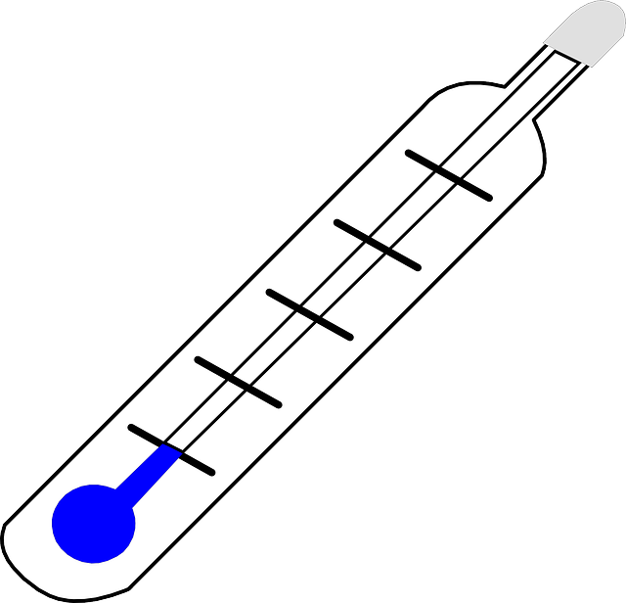
First things first
Gauge your feelings on a 1 to 5 scale: 1 is perfectly calm, 5 is extremely anxious
It helps to become aware of our levels of anxiety in any given situation
Some coping skills work well at lower levels, but may not be as effective once you are at a higher level
It also helps to identify when you are starting to feel anxious (a 2 or 3) and begin using coping skills before escalating to a 4 or a 5

Slide 5
Symptoms of anxiety at different levels
5 groups
What might you feel at each level? Physical, emotional, thoughts
1
2
3
4
5

Slide 6
Then what?
Once you have identified your level of anxiety (1-5) you can start to use some coping skills
Some coping skills are more effective at lower levels (1-3) but may not be as helpful at a 4 or 5
Specific coping skills will be discussed in detail in our next lesson
But, today we will focus on one thing that can help at any level…

Slide 7
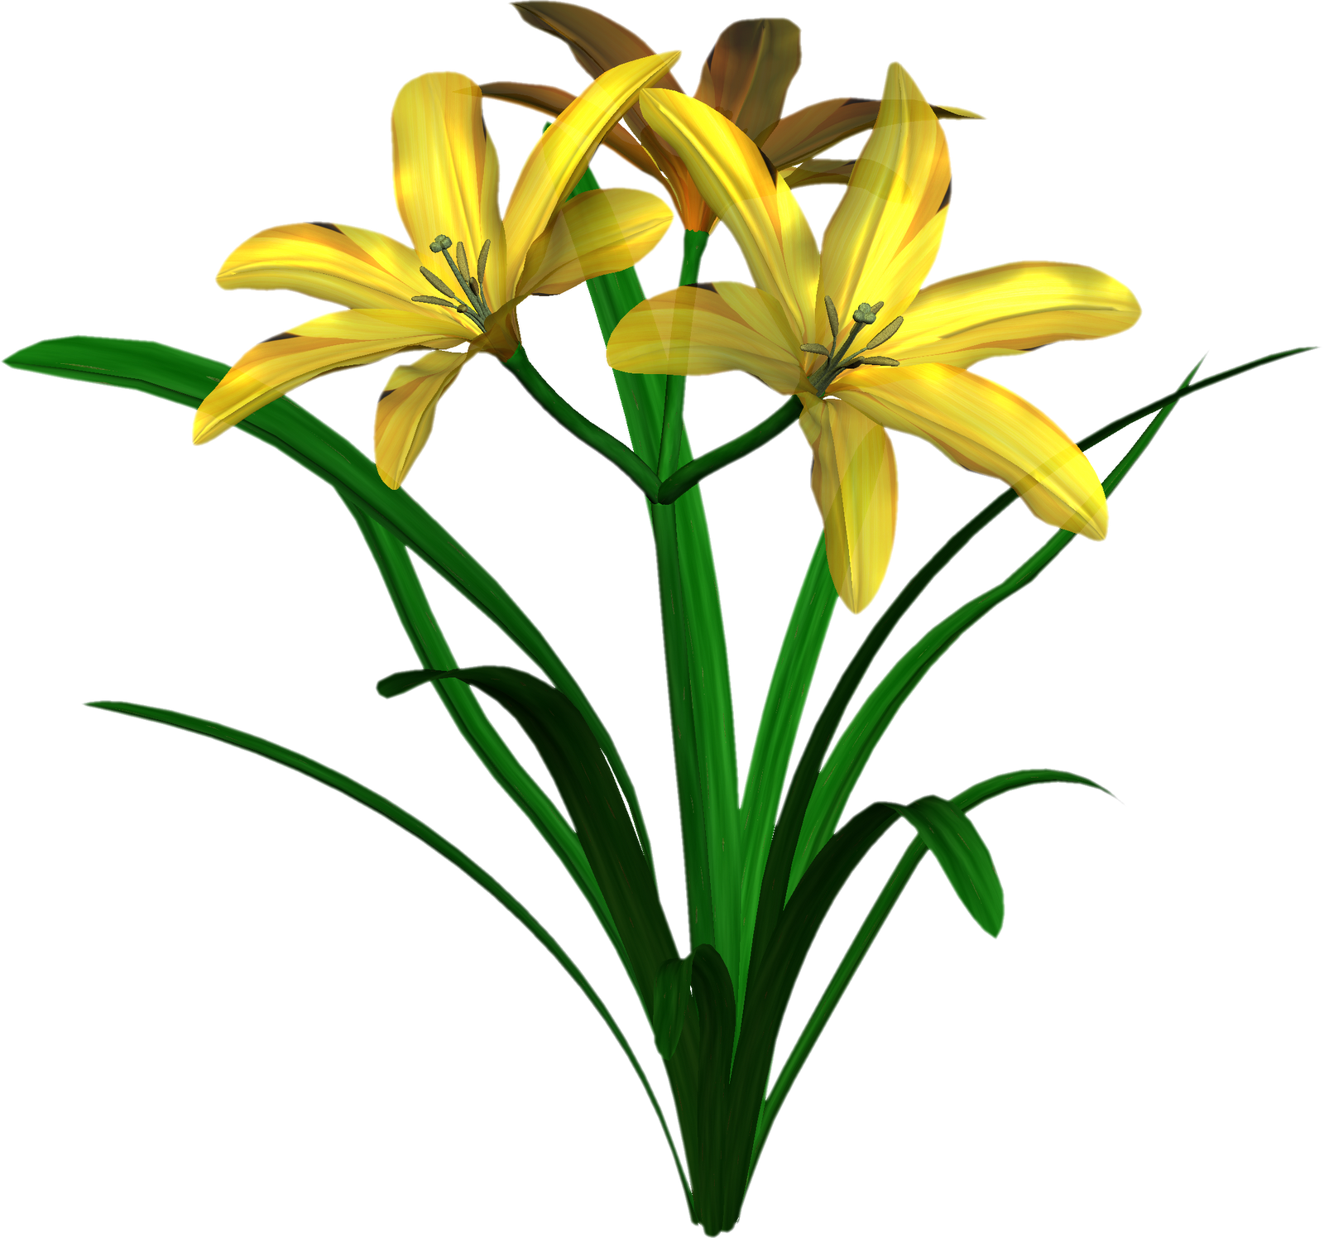
Deep breathing
Anxiety response (fight, flight or freeze) in the brain makes our heart beat faster, and our breathing gets more shallow. Less oxygen gets to the brain, and we can feel dizzy or have trouble focusing.
take slow, deep breaths
begins to slow your pulse, and get more oxygen to your brain, helping you feel more in control and think more clearly.
Just one deep breath isn’t enough!
It can help to imagine smelling a pleasant smell (flowers, cookies, etc) and then imagine blowing bubbles, or blowing out birthday candles

Slide 8
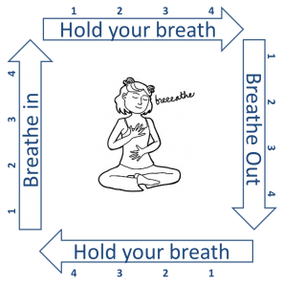
Square breathing
Slows down your pulse
begins to regulate blood flow and reverse the anxiety reaction
You can increase the counts to 6, then 8

Slide 9
Let’s try it!
Take your pulse
Let’s run! By running/dancing/moving, we will speed up your pulse and simulate the anxiety response in your body
Take your pulse again – how much did it speed up?
use Square breathing to bring our pulse back down (in, hold, out, hold)
Is your pulse back to normal? (60-100 bpm)
Did you notice any other changes

Slide 10
Wrapping up
Please answer the questions on the back of your paper
It’s important to be in tune with your own levels of anxiety in certain circumstances. A 5-point scale can help.
After that…

Slide 11
Just breathe!
https://www.youtube.com/watch?v=-YEZnrySrtQ

