Slide 1
anxiety
Descriptions and symptoms
BY: Mrs. degnan

Slide 2
What is anxiety?
Anxiety is a feeling of being worried about a threat or danger that might or might not happen
Can affect your thoughts, feelings and/or body
Your body’s built-in “red alert” system

Slide 3
Who gets anxiety?
EVERYONE!
It is normal to feel anxious when you are in a scary or stressful situation
IT IS ALSO IMPORTANT TO DEVELOP COPING STRATEGIES TO CALM DOWN!

Slide 4
Why do people have anxiety?
Anxiety helped protect early humans from danger
Process in the brain that helped them react quicker, be stronger, and remain alert
“Fight, flight or freeze”
Chemicals are released that prepare you to fight, run away, or stay perfectly still
When you perceive a stressful situation (a major test, public speaking, performance, etc.) it is very normal to feel nervous!
Anxiety becomes more significant when we have this fight, flight or freeze response very often, or for long periods of time

Slide 5
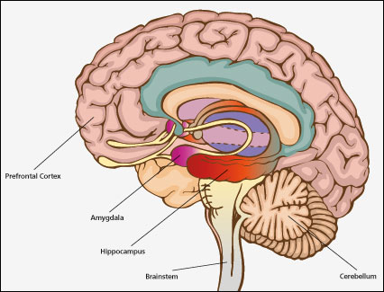
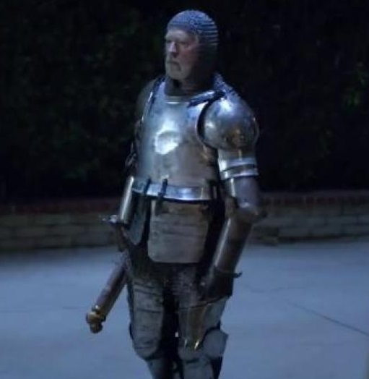
What happens in our brains?
HIPPOCAMPUS
STORES MEMORIES
AMYGDALA
REACTIVE
“GUARD”
PREFRONTAL CORTEX
“THE BOSS”
TAKES TIME TO REACT

Slide 6
Anxiety response in brains
brain is flooded with norepinephrine, cortisol and adrenaline
these are designed to increase your speed, reflexes and awareness
heart rate increases
more blood to your muscles
more oxygen to your lungs
This can be helpful in many ways when you do need to be on alert
This should “shut off” when the threat is over

Slide 7
Physical responses to normal levels of anxiety
Shaking hands
Faster heartbeat
Fidgety
Shallow breathing
Flushed face
Tight muscles

Slide 8
when does normal anxiety turn into something bigger?
In most people, feelings of anxiety begin when they enter a stressful situation, and they end when the situation is over
For many people, however, the anxiety response can happen any time, be very intesnse, or last for long periods of time
They have a heightened sense of “fight, flight or freeze” which can come on even when there is no actual danger
It is important to seek help from a doctor, counselor, or therapist if this happens
You can get better! (and it’s worth it!)

Slide 9
Physical effects of excessive levels of anxiety
Headaches
Stomach aches
Poor sleep
Racing heartbeat
Shakiness
Difficulty focusing and forming thoughts
Panic attacks

Slide 10
Plickers
Quick anxiety check-in
Your answers are anonymous
Turn your card so that your answer is on top
Make sure your fingers are not covering the blocks on your paper
https://plickers.com/

Slide 11
What’s next?
Identifying triggers of our own anxiety
Identifying our own levels of anxiety in a variety of situations
Coping skills for managing anxiety
When and how to ask for help

Slide 12
Exit slip (on the back of your plickers card)
Your name
What further questions do you have about anxiety?
Would you like to speak with me individually about your own anxiety?

